Slide 1

Rfid Application in Advance Motion Detection System
By
Sake Nawab Arzoo
Abhishek Sarkar
Rhitam Kaity
Pritam Kaity

Slide 2

INTRODUCTION
It’s a motion detection system refers to the capability of the surveillance system to detect motion and capture the events. Motion detection is usually a software - hardware based monitoring algorithm which, when it detects motions will signal the surveillance camera to begin capturing the event. Also called activity detection. An advanced motion detection surveillance system can also send the mail notification as well as video clip will be uploaded to internet.

Slide 3

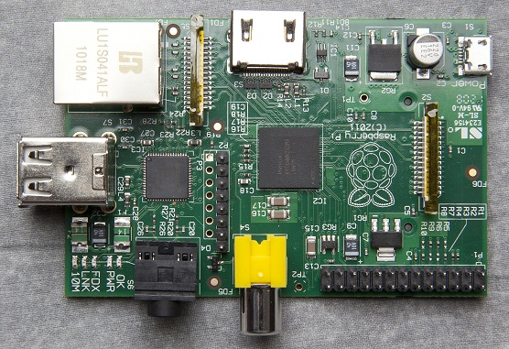

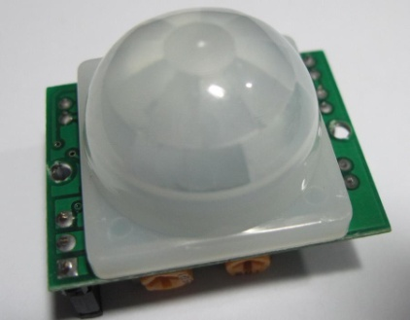
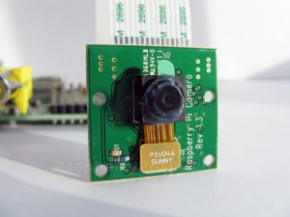
How Project works..
INTERNET
Mail and SMS Notification:
MOTION HAS BEEN DETECTED

Slide 4
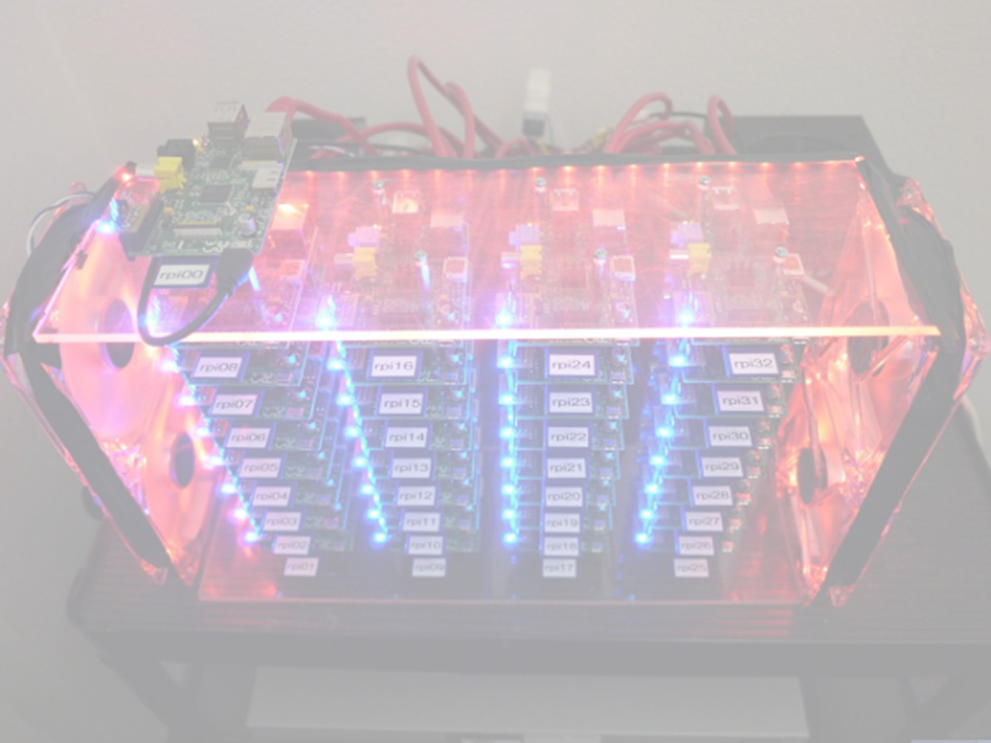
Quick Descriptions about the items :
The Raspberry Pi is a credit card-sized single-board computer developed in the UK by the Raspberry Pi Foundation with the intention of promoting the teaching of basic computer science in schools.
Passive Infrared Sensor (PIR sensor) allow you to sense motion, almost always used to detect whether a human has moved in or out of the sensors range. They are small, inexpensive, low-power, easy to use and don't wear out. For that reason they are commonly found in appliances and gadgets used in homes or businesses.
Dropbox is a home for all your photos, docs, videos, and files. Anything you add to Dropbox will automatically show up on all your computers, phones and even the Dropbox website - so you can access your stuff from anywhere.

Slide 5
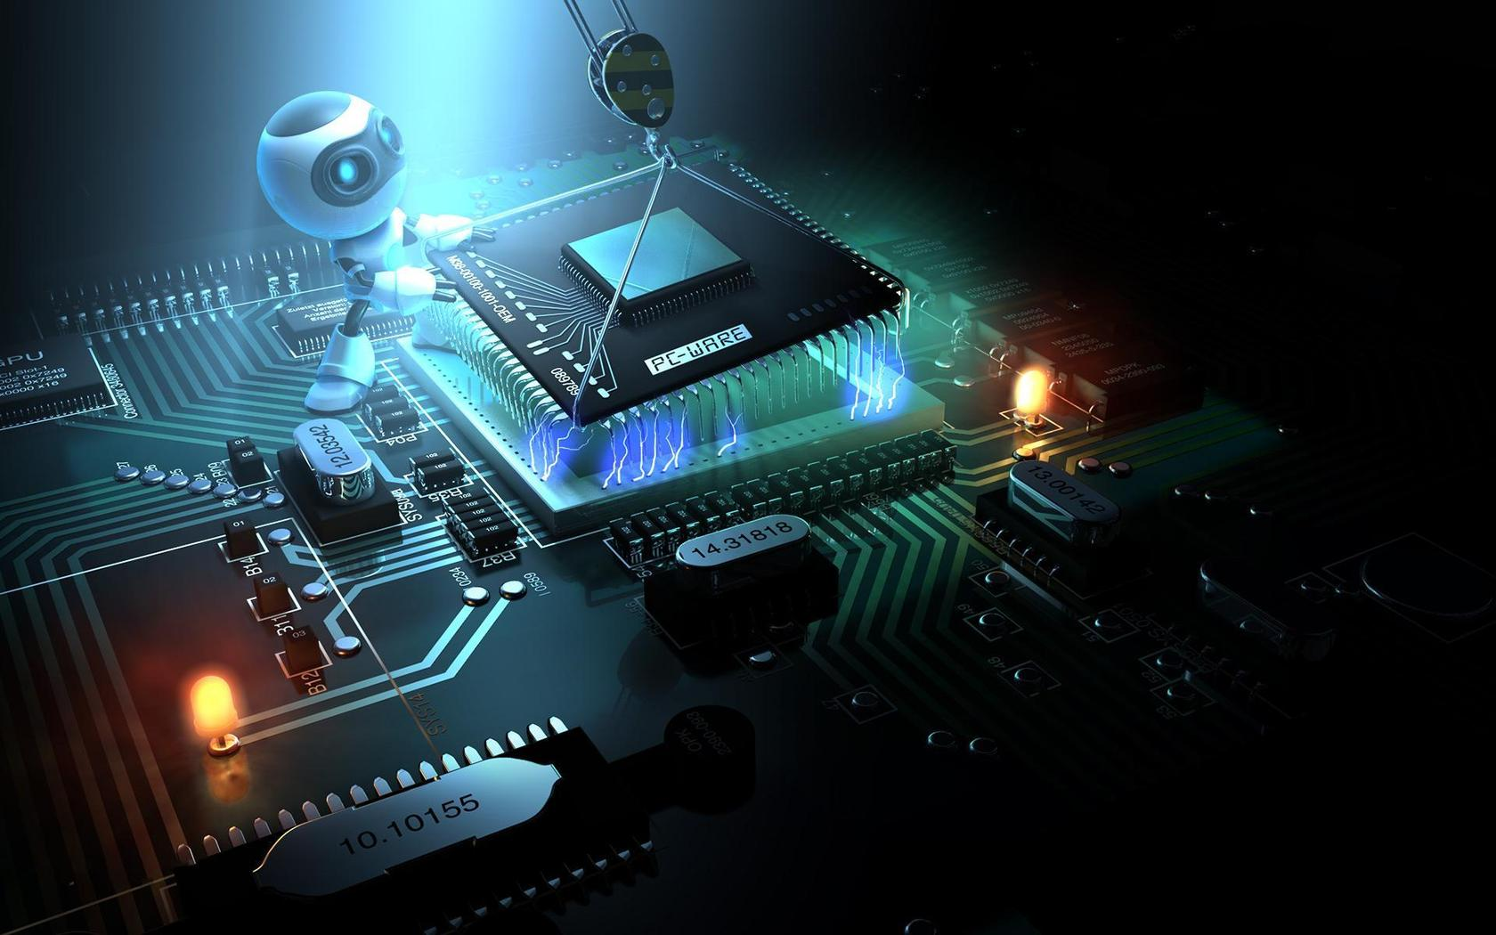
DESCRIPTION
Motion detection system is the first essential process in the extraction of information regarding moving objects and makes use of stabilization in functional areas, such as tracking, classification, recognition, and so on. In this project, we propose an idea and accurate approach to motion detection for the automatic video surveillance system. Our method achieves complete detection of moving objects by involving significant parts: motion detection by a sensitive PIR sensor, recording video footage by a camera module, all these are controlled by a raspberry pi. When a motion is detected by the PIR sensor then it sends a signal to the raspberry pi and then raspberry pi activates the camera and starts recording until the motion stopped. A mail notification is send to a given mail address and video footage is processed and then it will be uploaded to Dropbox and at last a SMS notification is being sent.

Slide 6
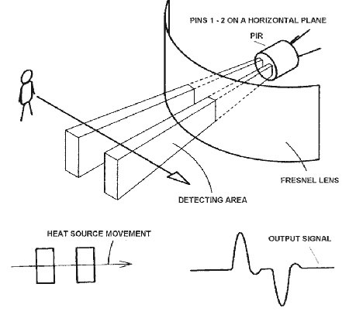
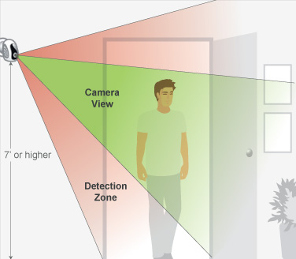
We will use Python programming language to write the codes in Raspberry Pi. Python is a widely-used high level programming language. Its elegant syntax allows you to clearly define application behavior using fewer lines of code than would be required in other languages like VB. It supports multiple programming paradigms including imperative, functional and object oriented styles, allowing a wide range of tasks to be performed.

Slide 7

USES OF THIS PROJECT
Could be used for monitoring your private items.
Could be used for home security.
Could be used for Wildlife Photography.
Could be used in parking areas for security purpose.
Could be used in banks Lockers .
and could be used for many other purposes..

Slide 8
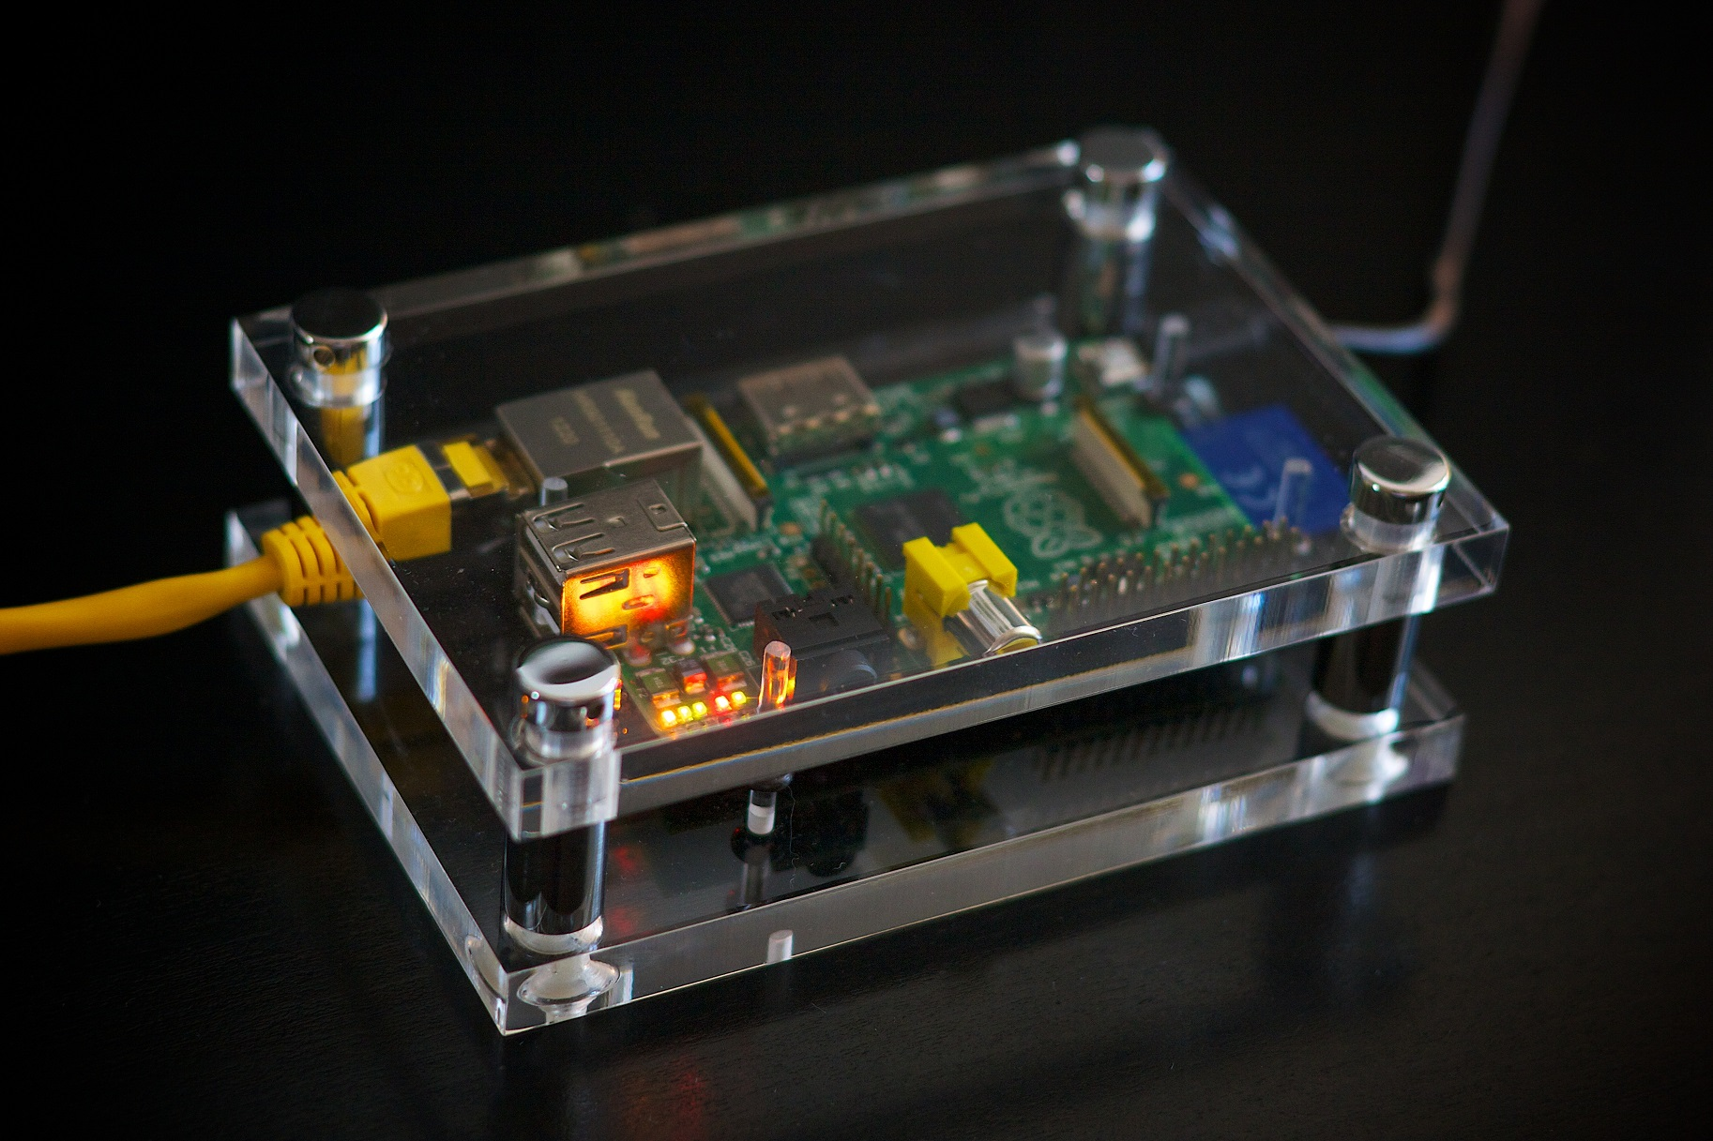
NEW IDEAS
It can also be used as a live video feeds as security camera. It would active when there is a motion (IR radiation) near the PIR sensor. It would generate a link and would be send via mail or SMS. That link can be used to view the live feed at that time .
By using ultrasonic sensor feature we can trigger alarm if someone wants to come close to a object (sensor would be hidden). Which add a bit more security to the previous project.
It can be also be used as a 24/7 surveillance system and will be uploaded google drive or Dropbox by simply switching to other script.
It can also be act as home security by adding some sensors to it and altering the script simply by a click .

Slide 9
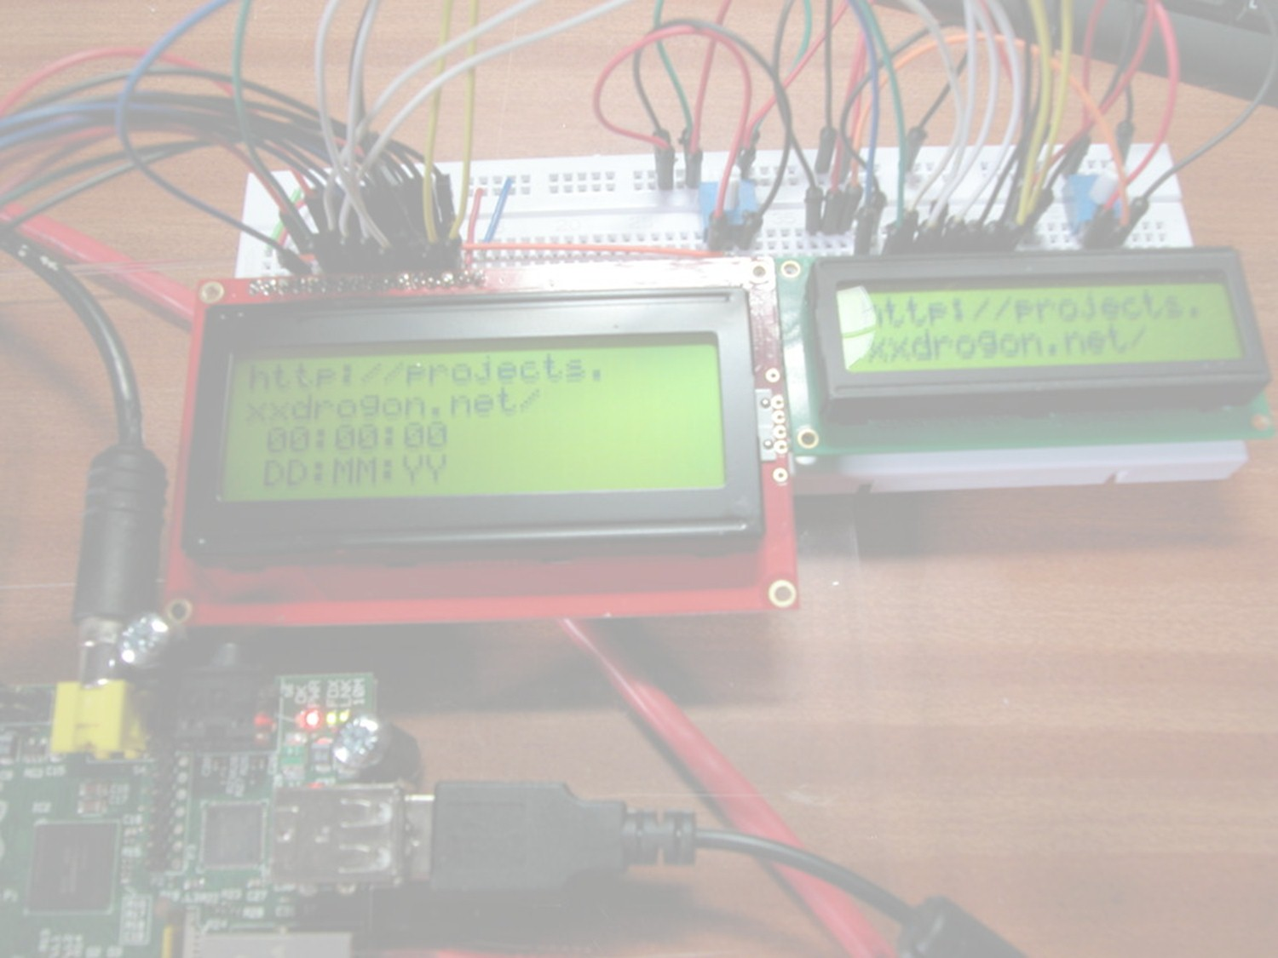
IMPLEMENTATION
This time it would work via application. It would have more features than previous with more stability lesser bugs and easy to use application.
Earlier we need to manually run the script on the pi to run the program. So we updated and bringing a application which would have different features like home security, protecting a particular things, live video stream, time-lapse video, and many more features which can be switched by simply a click on phone (internet needed on phone).
We are also adding RFID system to our previous system so as to authorize permissions to trusted people and work as previously for the rest.

Slide 10
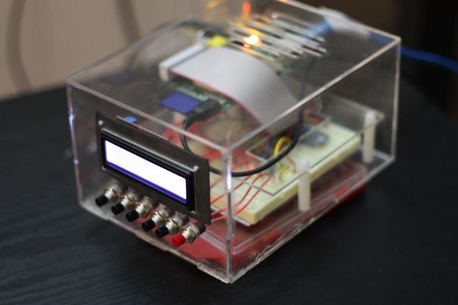
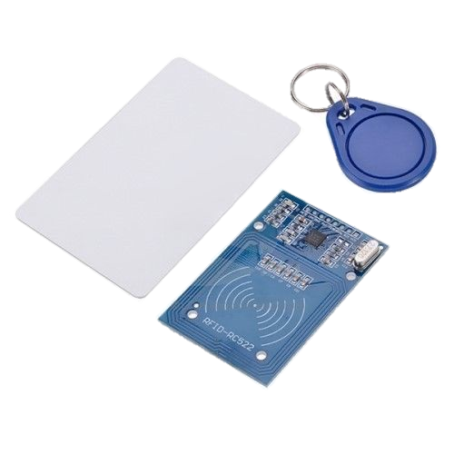
RFID Linkage
On our current system , we are going to attach an RFID module, specifically RC-522, to authorize permissions to 4-5 people for example so that if they enter into the secured area after swiping their own RFID tag, the automatic video footage won’t be captured. Any person without the tag if enters into the area, due to not swiping an authorized RFID tag, the system will work as it should and hence the system won’t give any false alarm.

Slide 11
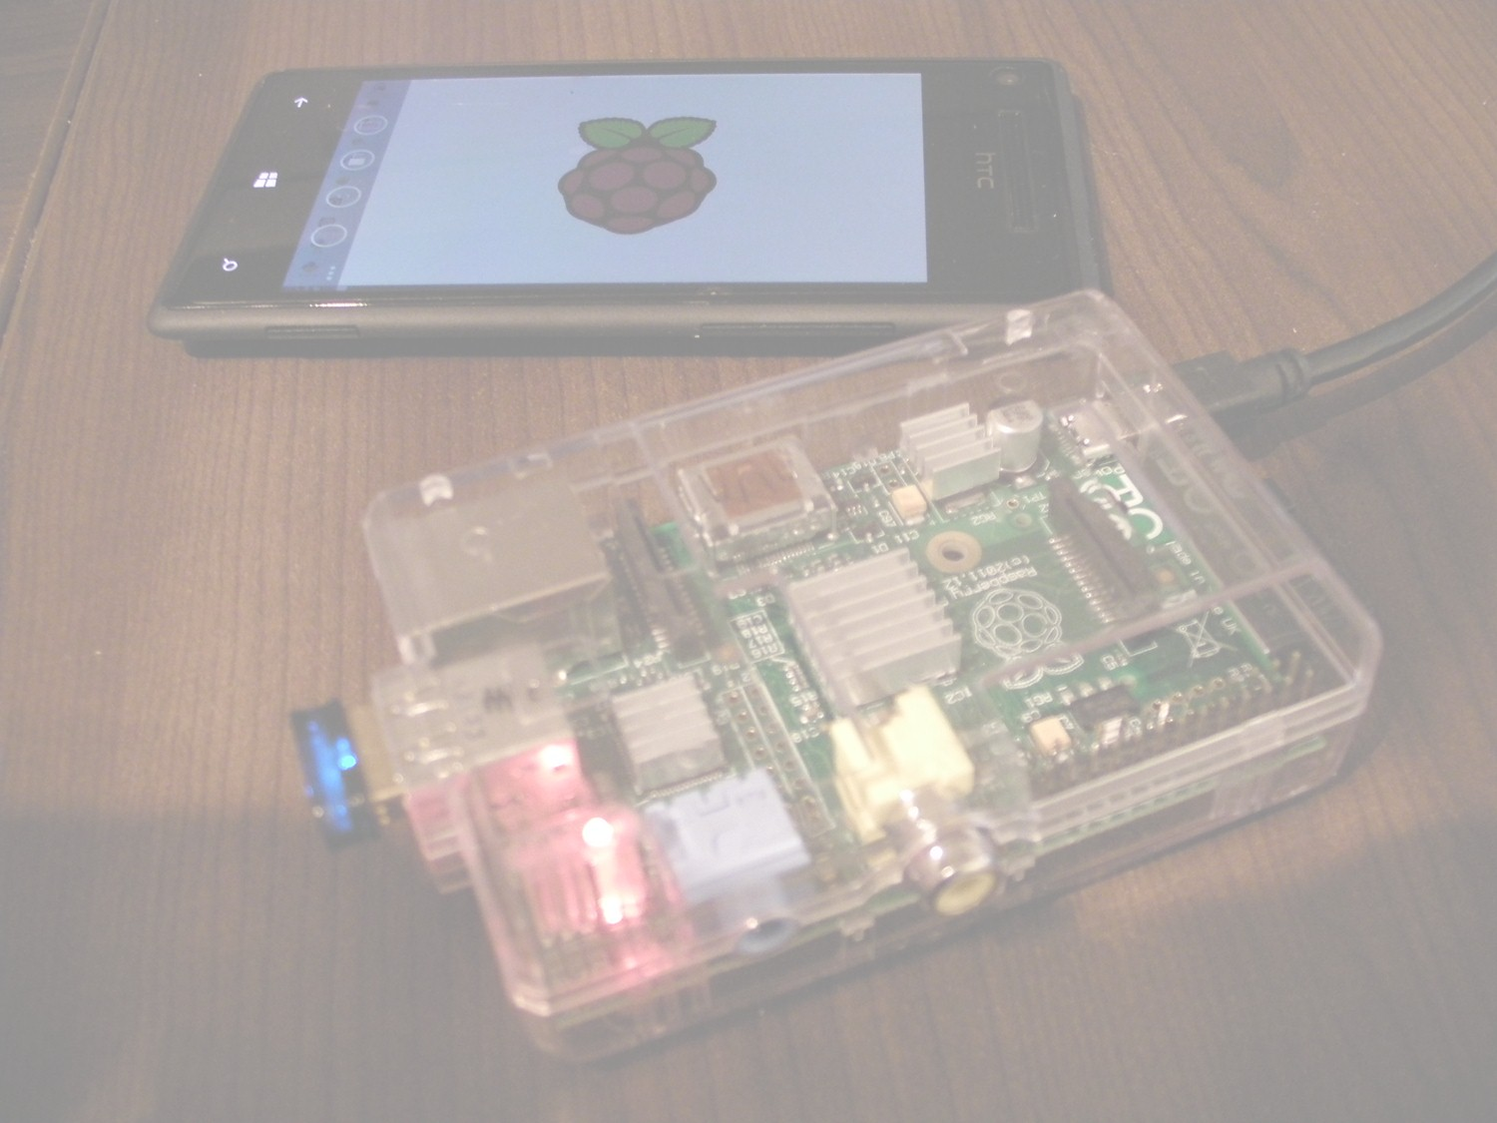
CONCLUSION
A Raspberry Pi can be used in different field and in different way for different works . It is just a single board computer which can perform almost like a computer .
In this project we have made a Advance Motion Detection System with the help of Raspberry Pi. The detection results produced by our proposed method were both qualitatively and quantitatively analyzed through visual inspection and for accuracy, along with comparisons to the results produced by other state-of-the-art methods. The analyses show that our method has a substantially higher degree of efficacy, outperforming other methods by an metric accuracy rate of up to 50 – 80 %.

Slide 12

Thank You….

